Slide 1
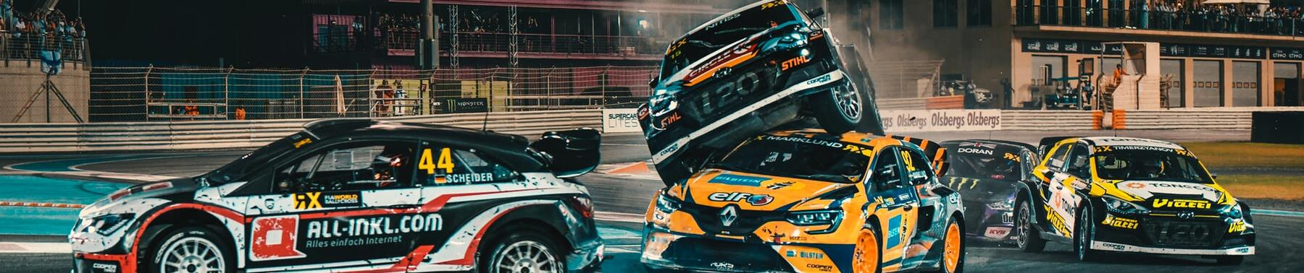
Road Traffic Accidents

Slide 2

About the project
This data set is collected from Addis Ababa Sub city police departments for Masters research work.
The data set has been prepared from manual records of road traffic accident of the year 2017-2020.
Source of data set : https://www.kaggle.com/datasets/saurabhshahane/road-traffic-accidents

Slide 3
About data set
Data set consists of 32 features and 12316 rows
Data set include (missing values _ Categorical data _ imbalanced classes)
Data set problem is classification problem

Slide 4
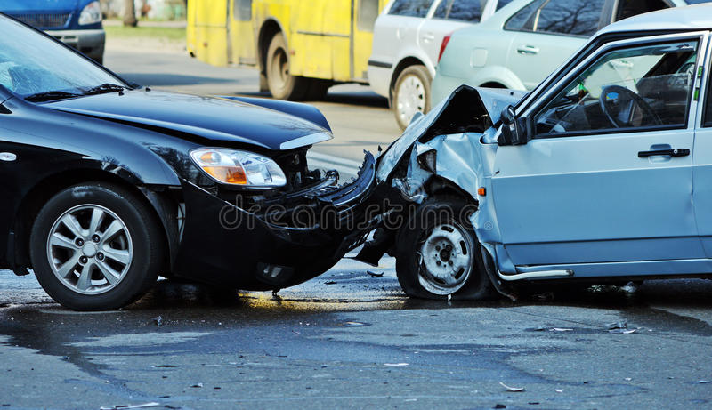
Data features
Time
Educational level
Owner of vehicle
Day of week
Vehicle driver relation
Service year of vehicle
Age band of
driver
Driving experience
Defect of vehicle
Sex of driver
Type of vehicle
Area accident occured

Slide 5
Data features
Lanes or Medians
Road surface conditions
Number of vehicles involved
Road alignment
Light conditions
Number of casualties
Types of Junction
Weather conditions
Vehicle movement
Road surface type
Type of collision
Casualty class

Slide 6
Data features
Sex of casualty
Fitness of causality
Age band of casualty
Pedestrian movement
Casualty severity
Cause of accident
Work of casualty
Accident severity

Slide 7

Analysis Questions :
what is the day and period of day when accidents happen the most ?
What is the age band of driver that has injury?
What is the age band of casualty that has injury? Escarpments
What is the service year of vehicles which happens with there injury?
What is the relation between light condition and accident severity ?
What is the relation between weather condition and accident severity ?
What is the relation between road surface condition and accident severity ?
What is the relation between light condition and accident severity ?
What is the most reason that cause accident with fatal injury ?
What is the relation between Type of collision and type of junction with accidents ?

Slide 8
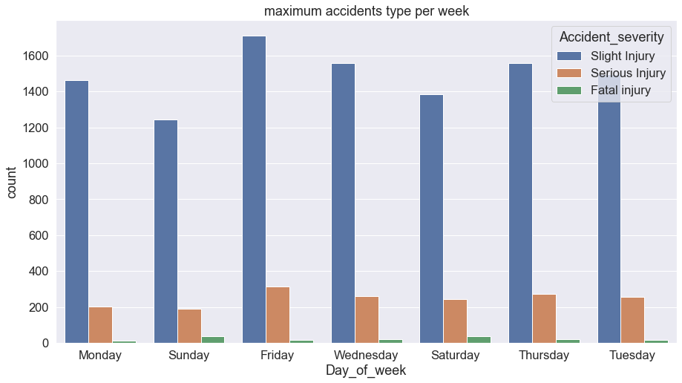
Analysis and recommendations

Slide 9
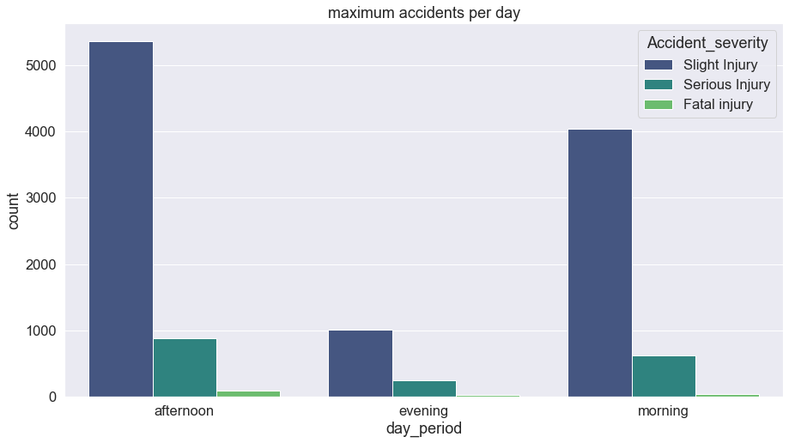
Analysis and recommendations

Slide 10
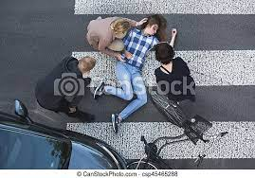
Analysis and recommendations
Age band of driver & age band of casualty
Slight Injury :
(Driver) 18-30
(casualty)
Serious Injury :
(Driver) 18-30
(casualty)
Fatal Injury :
(Driver) 18-30
(casualty)

Slide 11
Analysis and recommendations
Day and period of day
Slight Injury :
(Afternoon)(Friday) 1712
Serious Injury :
(Afternoon)(Friday) 313
Fatal Injury :
(Afternoon)(Saturday) 37

Slide 12
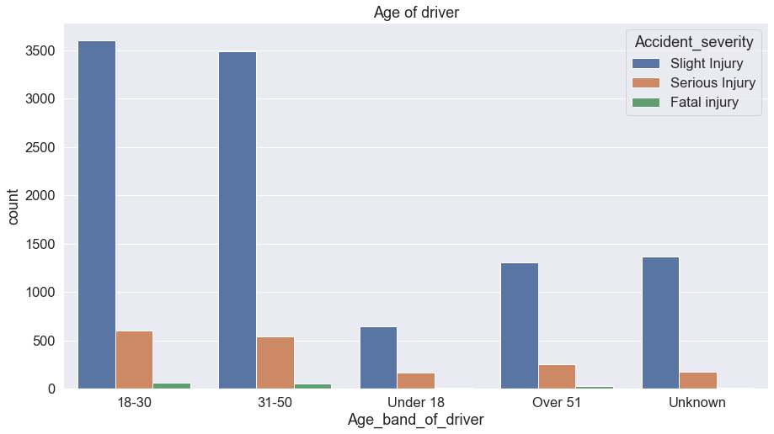
Age band of driver and age band of casualty

Slide 13
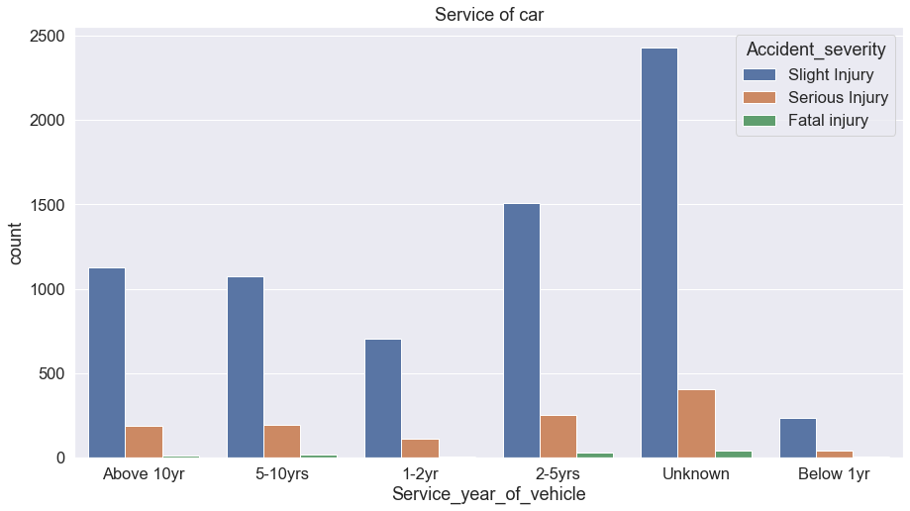
Analysis and recommendations
Service year of vehicles

Slide 14
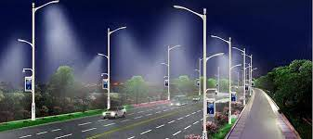
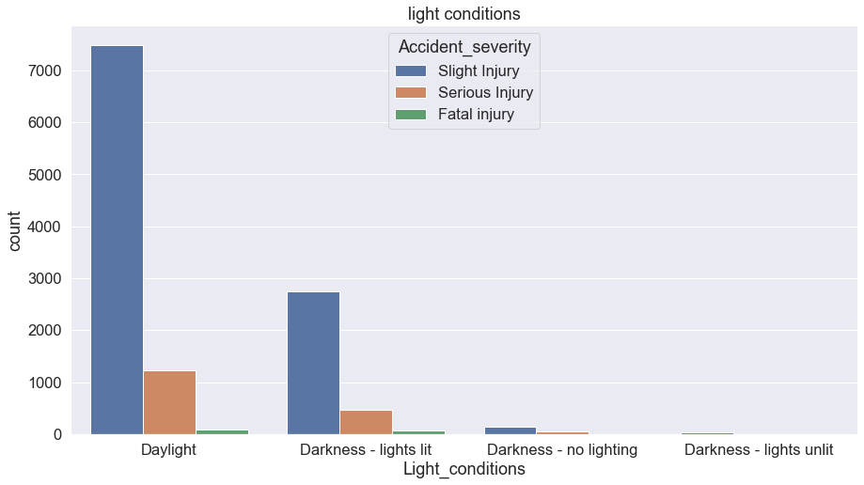
Analysis and recommendations
Light , weather and road surface conditions

Slide 15
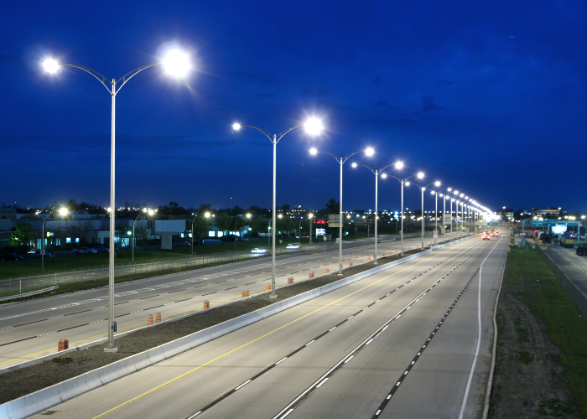
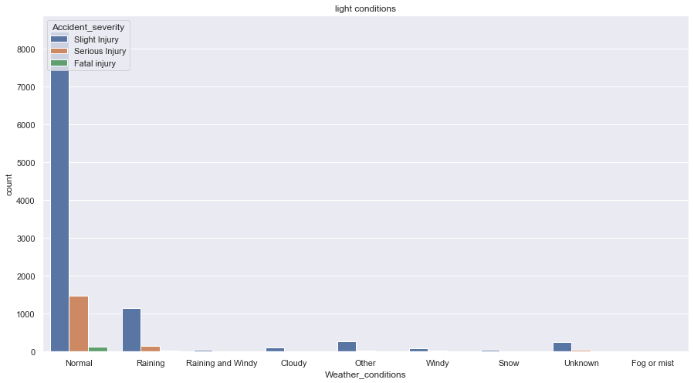
Analysis and recommendations
Light , weather and road surface conditions

Slide 16
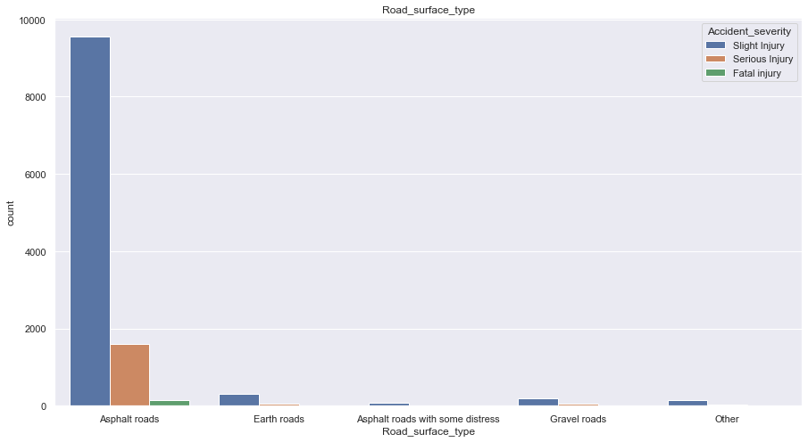
Analysis and recommendations
Light , weather and road surface conditions

Slide 17
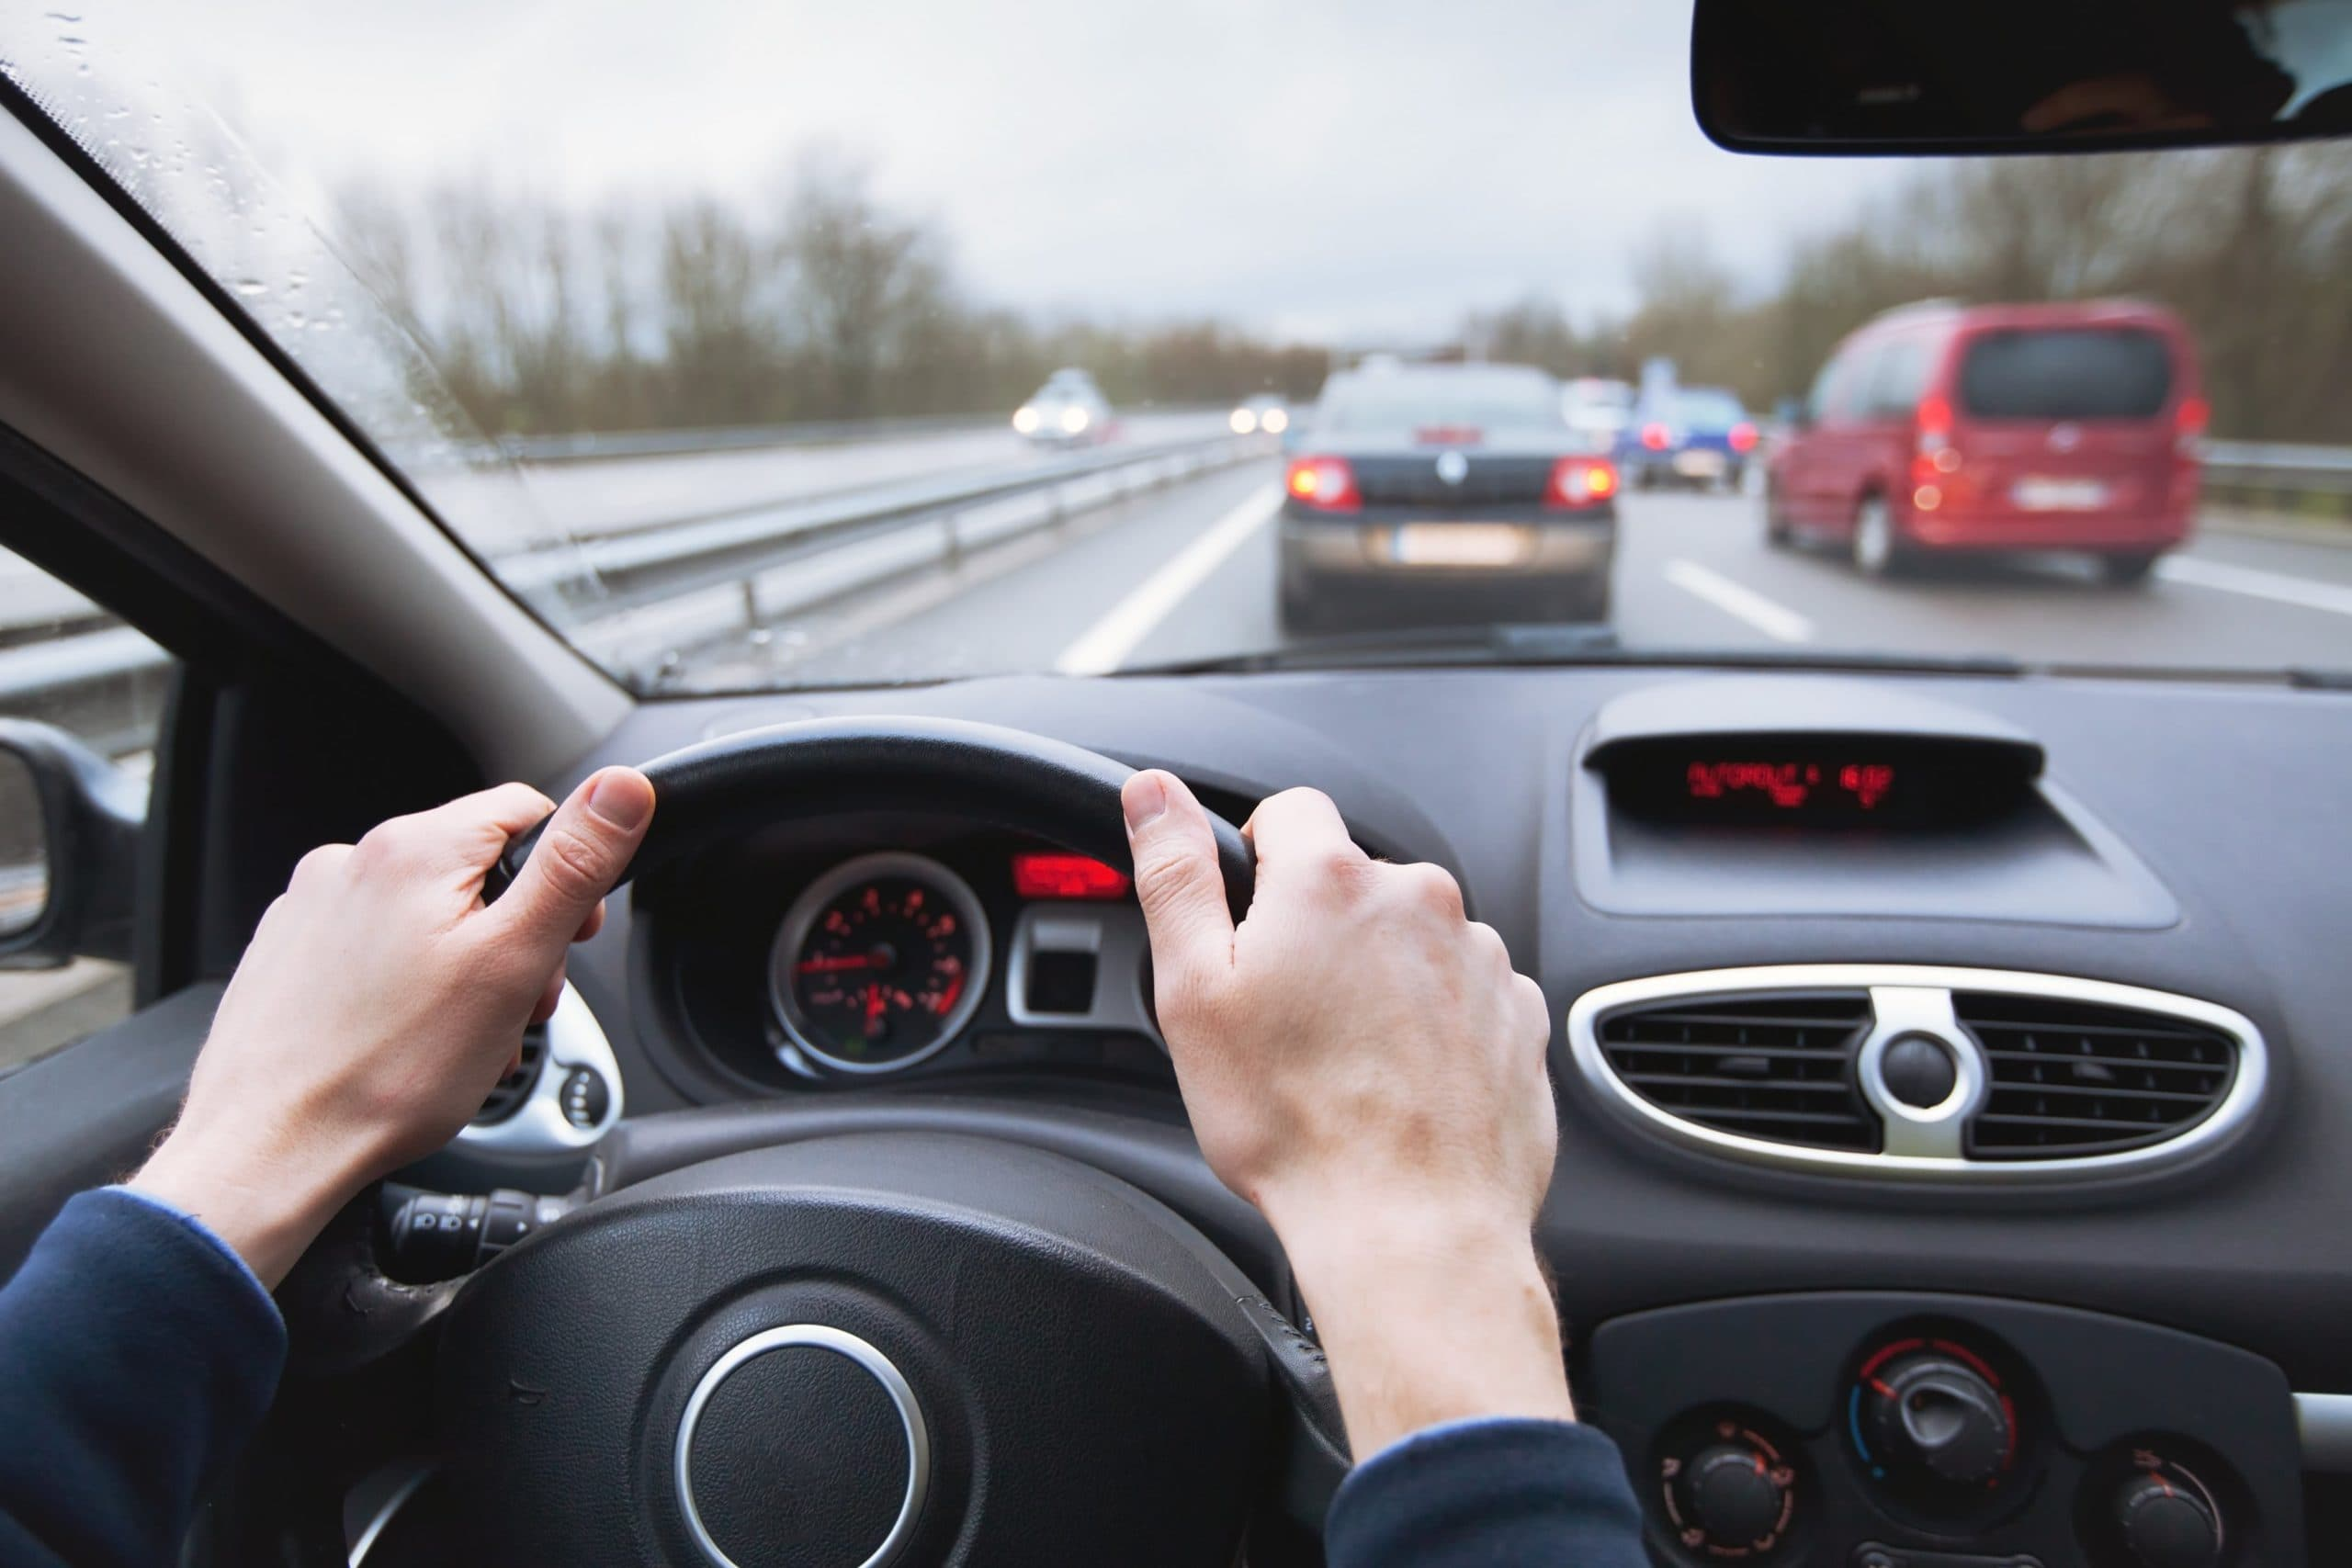
Analysis and recommendations
Most reasons that cause accidents
Slight Injury :
(No distancing) (Changing lane) (Driving carelessly)
1940 -- 2776 -- 1171
Serious Injury :
(No distancing) (Changing lane) (Driving carelessly)
303 -- 487 -- 209
Fatal Injury :
(Moving Backward) (Changing lane) (Driving carelessly)
26 -- 39 -- 22

Slide 18
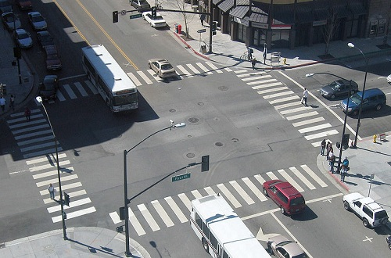
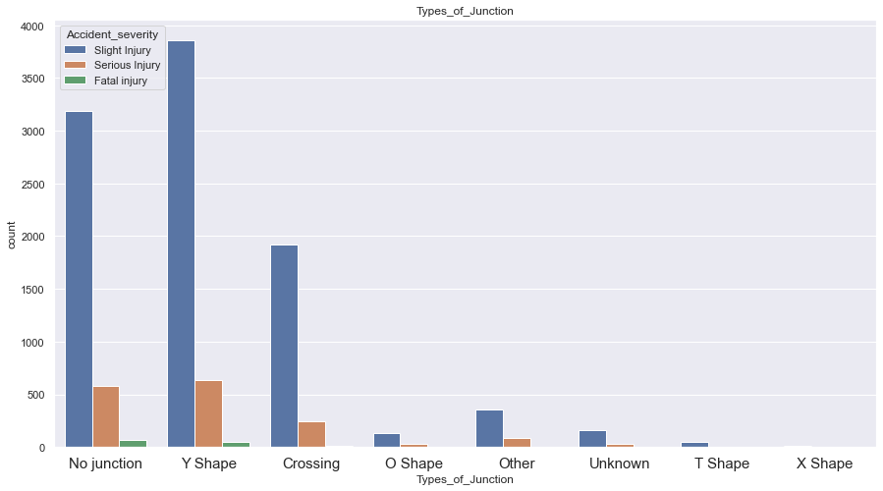
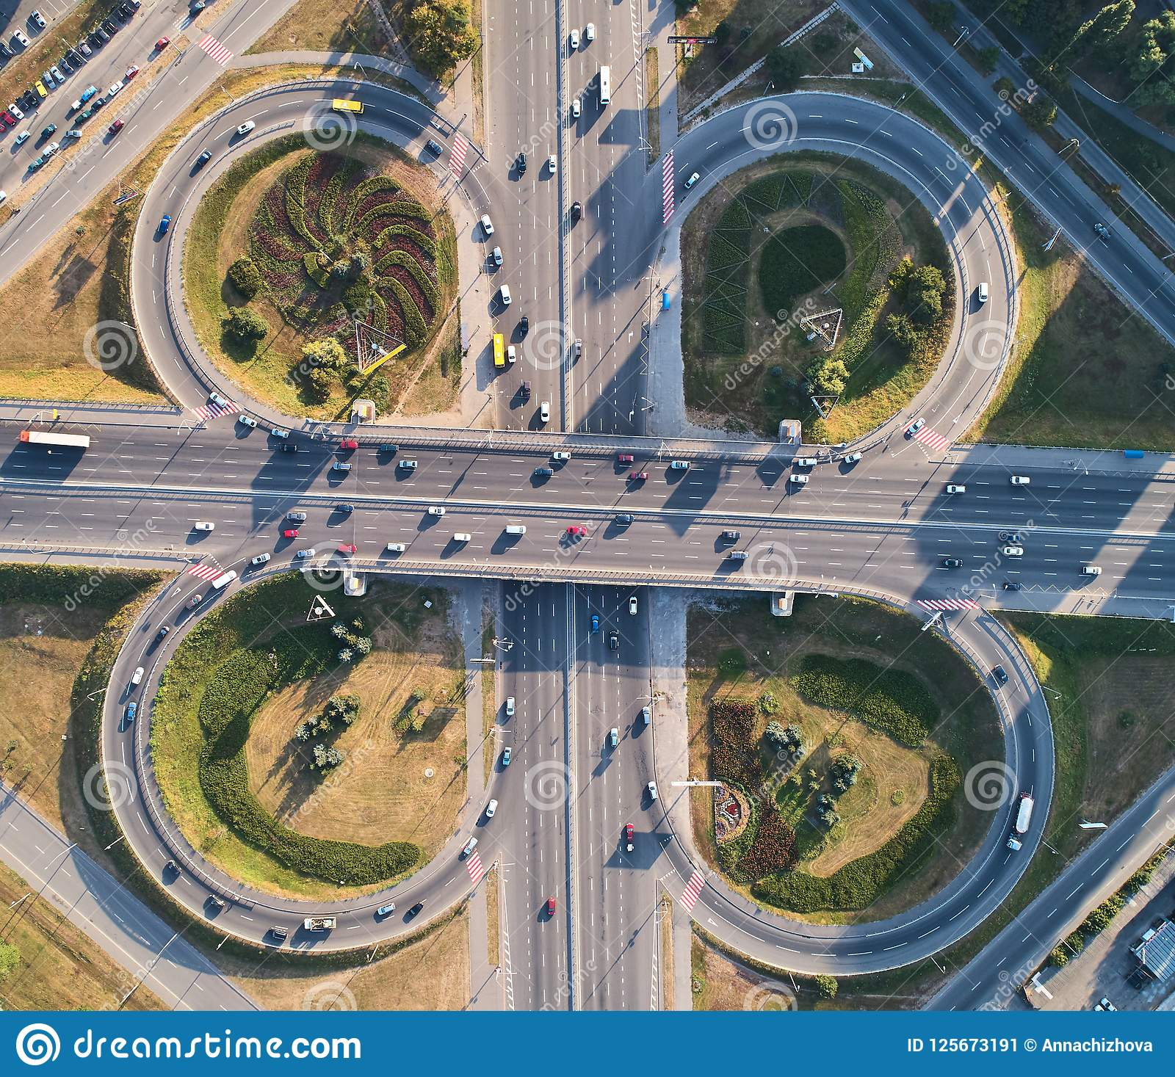
Types of junctions

Slide 19
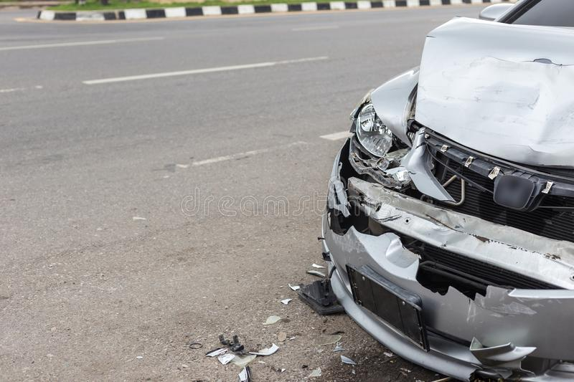
Analysis and recommendations
Type of collision
Slight Injury :
(Vehicle with vehicle) (Collision with roadside) (with pedestrians)
7467 -- 1490 -- 733
Serious Injury :
(Vehicle with vehicle) (Collision with roadside) (with pedestrians)
1203 -- 272 -- 141
Fatal Injury :
(Vehicle with vehicle) (Collision with roadside) (with pedestrians)
104 -- 24 -- 22

Slide 20


Analysis and recommendations
We suggest to setting speed in Friday and Saturday just in afternoon period .
We suggest to make additional lectures for people in age band from 18 to 30 when they want to extract driving license .
We suggest to make continuously examination for vehicles with 2-5 year .
We suggest to setting speed and make continuously examination for (automobiles and lorries and pick up ) .
We see that there is no effect from (weather , light , road surface ) conditions because most of accidents occur in normally conditions .
We see that a lot of accidents occur due to (no distance , changing lanes , moving backwards and driving careless ) so we suggest to put fines for drivers who do that .

Slide 21
Analysis and recommendations
We see that drivers with educational level like (junior high school , elementary school) make a lot of serious and fatal accidents so we suggest to make them more lectures and instructions while the extracting driving license .
We see that (y _ shape & o – cross) junctions make a lot of lot of serious and fatal accidents so we suggest to decrease them .

Slide 22
Thank you

